Slide 1


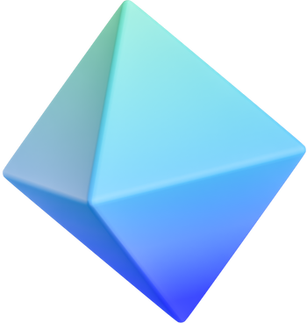

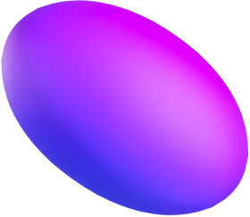



DSC 682-002
GROUP 4
Business Description Embeddings
UMAP VISUALIZATION
DALIA DO | TUAN LE | KHUE NGUYEN

Slide 2
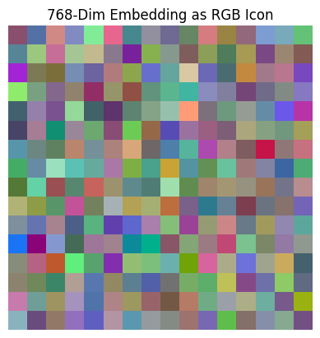
PART 1
1. Introduction about the project
2. Data Preparation & Cleaning
DATA PREPARATION & CLEANING

Slide 3
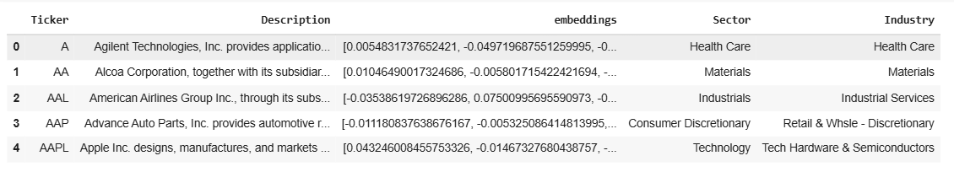
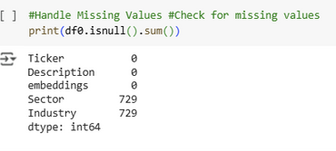
-
DATA PREPRATION & CLEANING
PROJECT INTRODUCTION
Visualize relationships between companies based on their business descriptions.
Use sentence transformer embeddings to convert text into numeric vectors.
Apply UMAP to project high-dimensional data into a 2D visual space.
Objective: Discover sector patterns and outliers through visualization.
Loaded dataset with company tickers, descriptions, sectors, industries, and precomputed embeddings.
2. Identified 729 missing values in Sector and Industry columns.
PURPOSE
Help businesses and analysts
Identify industry clusters
Potential competitors
Investment opportunities
based on business model similarity, even when textual descriptions differ.
3. Applied keyword filtering to detect ETF-related descriptions (e.g., “ETF”, “track the index”),
rows with ETF-like descriptions and missing sector info were labeled as:
Sector = ETF
Industry = ETF
.
4. Remaining missing values were labeled as Unknown to retain all data.
-.> Final dataset had no missing values and was ready for analysis.

Slide 4
PART 2
EXPLAINING
SENTENCE EMBEDDINGS
1. Explaining Sentence Embeddings
2. Visualizing Sentence Embeddings

Slide 5
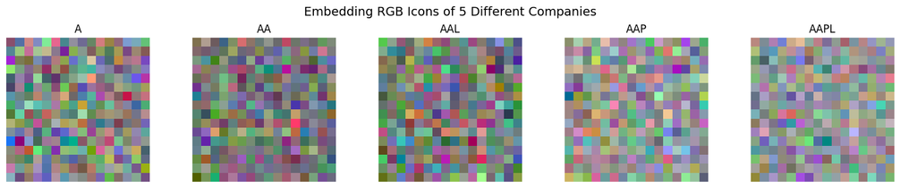
-
EXPLAINING & VISUALIZING
SENTENCE EMBEDDINGS
WHAT ARE SENTENCE TRANSFORMER EMBEDDINGS?
A sentence embedding is a vector of numbers that captures the meaning of a sentence.
It’s like a semantic fingerprint of the text — enabling comparison based on meaning, not keywords.
VISUALIZING AN EMBEDDING
WHAT DOES A SENTENCE TRANSFORMER DO?
We reshaped each embedding into a color icon to represent the company's business meaning.
The result: A visual fingerprint — the color patterns reflect unique text characteristics.
Helps us intuitively compare different companies.
Converts an entire sentence (or company description) into a fixed-length numeric vector.
Input: text, like whole sentences
Sentence Transformer: Converts text to embeddings
Output: Vector of numbers
WHAT IS THE GOAL OF EMBEDDINGS?
Not just assign every word to a vector a numbers.
But also to ensure that words of similar meaning are close together numerically.
WHY 768 DIMENSIONS?
A Picture is Worth a Thousand Words
Just like an image compresses a lot of visual detail, an embedding compresses a lot of textual meaning.
We can’t read these embeddings directly, but we can visualize them to compare companies.
Each color pattern is a compact representation of what the company does.
The BERT model used for sentence embeddings has an output size of 768.
Conveniently, 768 = 16 × 16 × 3 → can be visualized as a 16×16 RGB image.

Slide 6
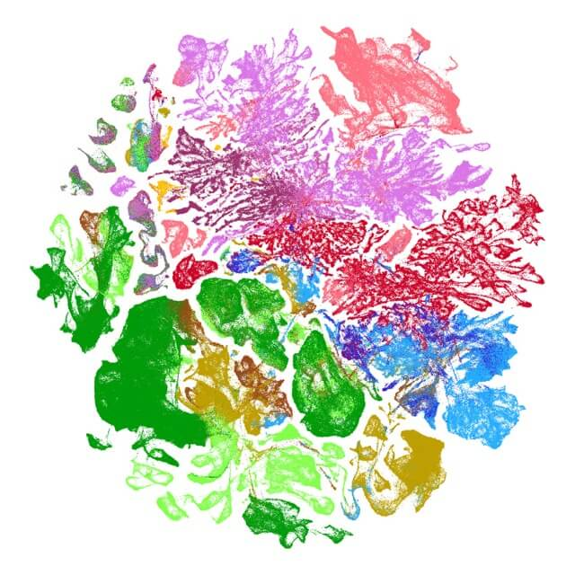
1. Understanding UMAP:
What UMAP does to the embedding space.
2. UMAP Parameter Demonstration
3. Parameter Impact on Layout
4. Applying UMAP to Business Sectors
PART 3
EXPLANATION OF UMAP

Slide 7
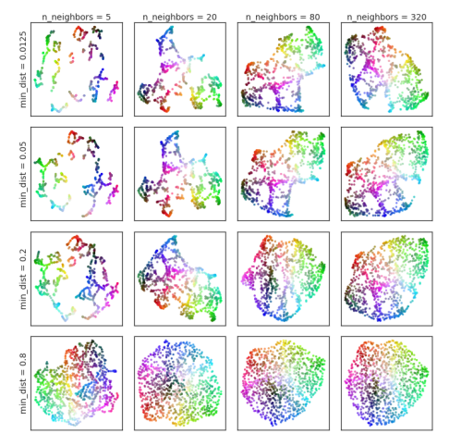
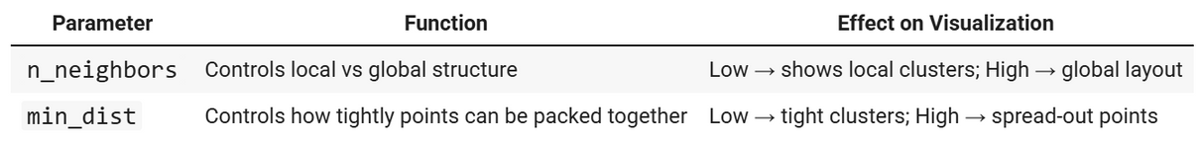
WHAT IS UMAP?
UMAP (Uniform Manifold Approximation and Projection) is a dimensionality reduction technique.
It helps us visualize high-dimensional data, like 768-dimensional sentence embeddings, by projecting them into 2D or 3D space, while preserving meaningful relationships.
Reduces text embeddings → visual clusters
Similar components stay close
Dissimilar ones are pushed apart
Ideal for finding hidden patterns in business descriptions
What UMAP does to the embedding space?
UMAP’s behavior is controlled by two key parameters:
These two parameters let us balance between seeing fine detail and overall patterns.

Slide 8
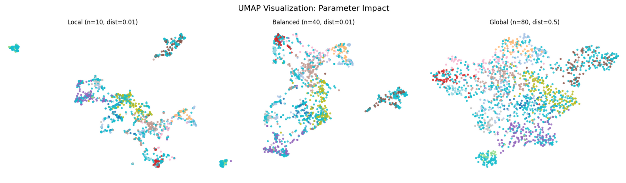
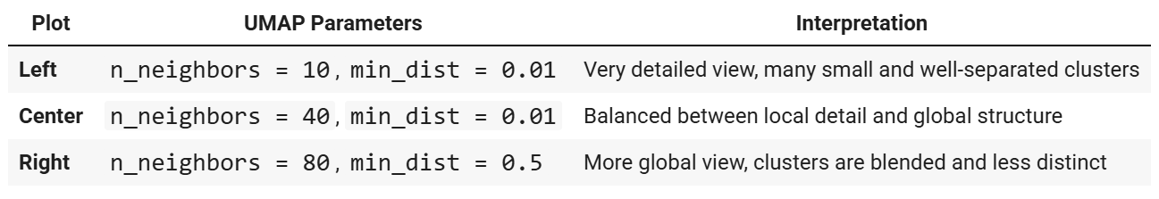
UMAP PARAMETER DEMONSTRATION
What Happens When We Change the Settings?
UMAP Visualization: Parameter Impact

Slide 9
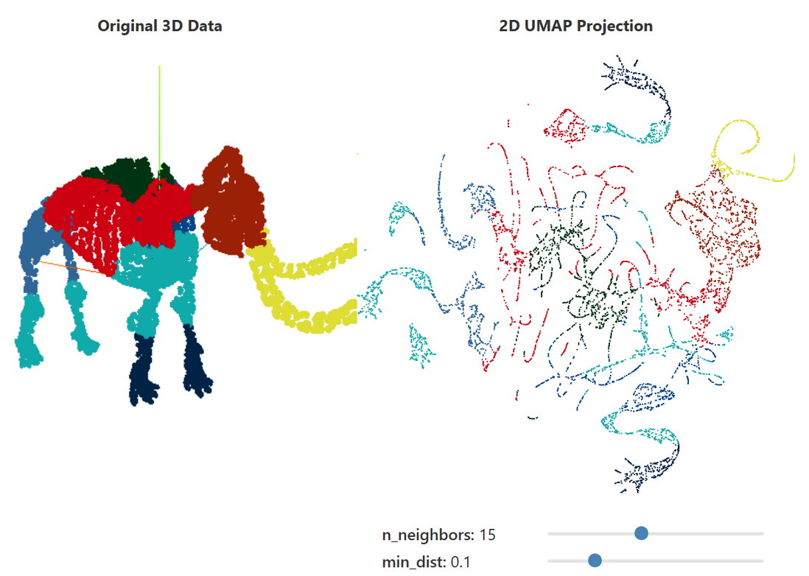
PARAMETER IMPACT ON LAYOUT
Woolly Mammoth Example
This classic 3D-to-2D projection shows how UMAP preserves shape and clusters.
Adjusting n_neighbors changes how much of the skeleton UMAP tries to preserve.
Lower min_dist keeps similar bones closer (like how we want similar companies clustered).
This analogy helped us understand how clusters in our data emerge.
By changing UMAP’s settings, we can control:
n_neighbors: How much local vs global structure is preserved.
Lower values (e.g. 5–10) → sharper, small clusters (e.g. niches like biotech).
Higher values (e.g. 40+) → smoother, broader structure (e.g. major sectors like “Technology”).
min_dist: How tight or spread out clusters are.
Low values (e.g. 0.01) → tight, distinct clusters (easier to separate sectors).
Higher values (e.g. 0.5) → more overlap, less visual separation.
Figure 5: UMAP projections of a 3D woolly mammoth skeleton (50k points, 10k shown) into 2 dimensions, with various settings for the n_neighbors and min_dist parameters.

Slide 10
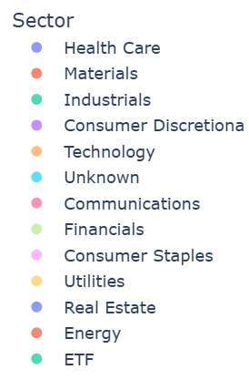
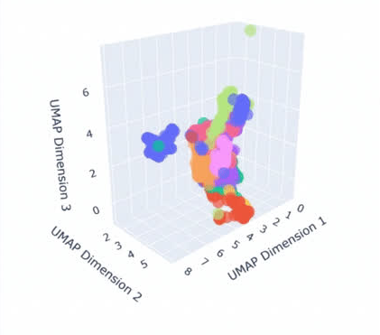
APPLYING UMAP TO BUSINESS SECTORS
What This Means for Sector Visualization?
3D UMAP plot
In our project: n_neighbors = 40 gave us a balance between detailed clusters and broader sector layout min_dist = 0.01 created tight clusters where meaningful
Clear separation emerged for ETFs, Utilities, Real Estate Some sectors like Technology and Discretionary showed blending — which reflects real-world overlaps in business models
Key Takeaways: UMAP is a powerful way to visualize complex text data Parameter tuning is critical for seeing meaningful structure In our case, balanced UMAP settings revealed natural sector groupings It helped us transform text into actionable business insight

Slide 11
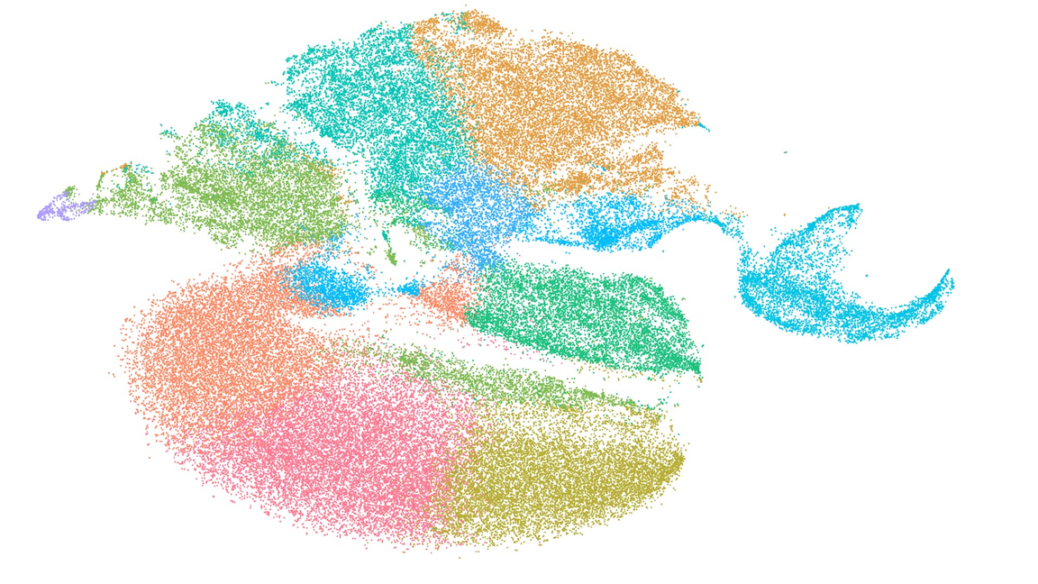
PART 4
1.Apply UMAP to create 2D visualizations of the business description embeddings
2.Sector and Industry-Level Clustering Analysis
3.Additional Analysis: Cross-Sector Similarities
KEY VISUALIZATIONS ANALYSIS WITH INSIGHTS

Slide 12
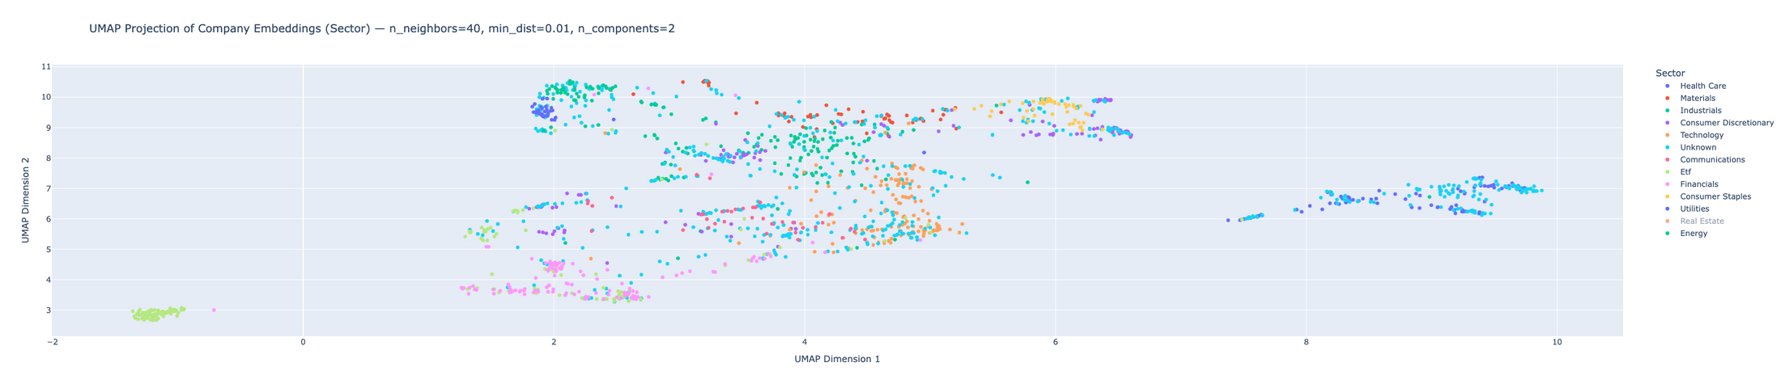
APPLY UMAP TO CREATE 2D VISUALIZATIONS OF THE BUSINESS DESCRIPTION EMBEDDINGS (BY SECTOR)
Key Observations:
1. Clear sector-level clustering is visible:
ETFs form a compact, isolated cluster in the lower-left — likely due to consistent phrasing like “seeks to track index” and “fund objective.”
Technology, Healthcare, and Financials exhibit well-formed clusters, reflecting dense and specific industry language.
Utilities and Energy also show tight local groupings, suggesting strong semantic cohesion within those industries.
2. Overlap exists between sectors with similar business models:
Consumer Discretionary and Industrials are partially entangled, as both may involve manufacturing, retail, and logistics terms.
Unknown labels appear scattered, indicating poor embedding consistency or insufficient description data.
3. Global structure is preserved thanks to n_neighbors=40, while tight intra-sector clustering is emphasized by min_dist=0.01.

Slide 13
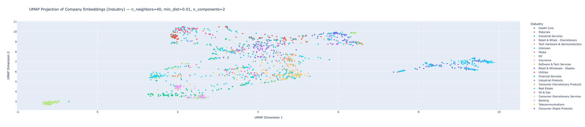
APPLY UMAP TO CREATE 2D VISUALIZATIONS OF THE BUSINESS DESCRIPTION EMBEDDINGS (BY INDUSTRY)
Key Observations:
1. Tight Industry Clusters: Etf, Health Care, and Oil & Gas companies are clearly isolated and tightly packed.
This indicates highly consistent language across those industries (e.g., “fund seeks to track index” or “petroleum production and refining”).
2. These two industries — both under the broader Technology sector — form distinct clusters.
This shows that UMAP successfully captures nuanced differences between:
Service/platform-focused language ("cloud", "API", "software")
Hardware-focused terminology ("semiconductors", "processors", "devices")
3. Retail & Consumer Product Fragmentation: Industries like Retail & Wholesale (Discretionary vs. Staples) and Consumer Discretionary Products appear more scattered.
4. Financial Services & Banking: Insurance, Financial Services, and Banking all show related but distinct positioning, indicating shared terminology (e.g., “risk,” “credit,” “products”) with differences in specific offerings like “lending” or “underwriting.”
5. Unknown Industry Scatter

Slide 14
DIFFERENCES BETWEEN INDUSTRY & SECTOR
Feature | Sector UMAP | Industry UMAP
Color Groups | 11–12 broad categories (e.g., Technology, Energy, Healthcare) | 20+ fine-grained subgroups (e.g., Software & Tech Services, Oil & Gas)
Granularity | High-level classification | More specific, detail-rich classification
Cluster Shape | Larger, smoother blobs (each sector contains many industries) | More scattered points and tighter sub-clusters within sectors
Interpretation | Good for spotting macro patterns across the market | Ideal for discovering industry-specific similarities/outliers
Use Case | Sector-level segmentation, marketing strategy, fund analysis | Industry benchmarking, niche competitor analysis, deep dives

Slide 15
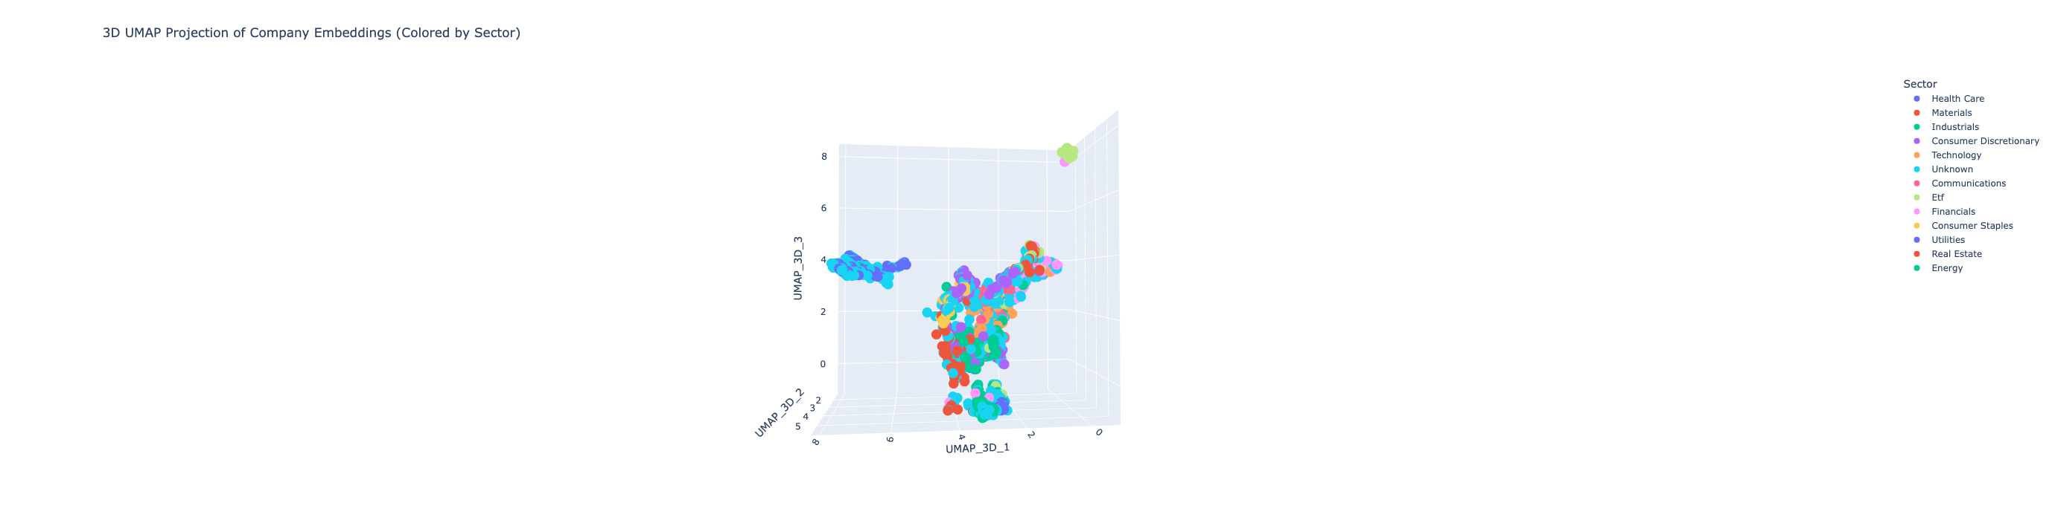
APPLY UMAP TO CREATE 3D VISUALIZATIONS OF THE BUSINESS DESCRIPTION EMBEDDINGS (BY SECTOR)
Key Observations:
1. Enhanced Depth with 3D Clustering
The additional dimension helps separate overlapping clusters that appeared tightly packed in 2D.
Sectors like Technology, Financials, and Health Care show stronger separation in 3D space, reducing visual overlap and aiding interpretability.
2. Isolated ETF Cluster
ETFs remain highly concentrated in one corner, consistent with their repetitive and structured descriptions (e.g., “tracks index,” “fund objective”).
This confirms they are linguistically unique, making them easily separable.
3. Dispersed “Unknown” & Mixed Sectors
Companies with “Unknown” sector labels are scattered across the embedding space, sometimes mingling with known clusters.
This highlights that some “unknown” companies may semantically resemble real sectors — a potential opportunity to infer missing labels from proximity.
The third dimension adds critical space for UMAP to preserve both local detail and global structure, allowing tight sub-clusters to co-exist without flattening or crowding. This makes 3D UMAP especially valuable for:
Detecting subtle industry shifts
Exploring hybrid companies (e.g., Fintech)
Creating immersive presentations of business similarity

Slide 16
IDENTIFY AND INVESTIGATE INTERESTING PATTERNS OR OUTLIERS
Oil & Gas Companies Dominate Outliers Many outliers belong to the Energy sector, especially the Oil & Gas industry, such as: CVX (Chevron), XOM (ExxonMobil), EOG, FANG, PTR, SNP
Unknown Sector/Industry Labels Several companies have Unknown for both Sector and Industry, such as: SHLX, OAS, SN, CEO, IMO
Marine Transportation Company as a Unique Outlier: KEX (Kirby Corporation) — an Industrial company specializing in marine barges

Slide 17
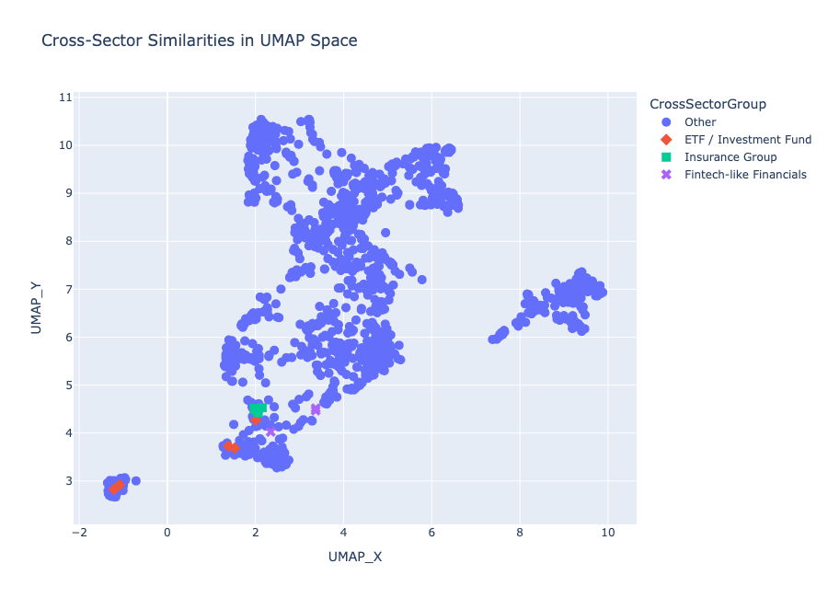
ADDITIONAL ANALYSIS:
CROSS-SECTOR SIMILARITIES: IDENTIFY INDUSTRIES FROM DIFFERENT SECTORS THAT CLUSTER TOGETHER AND EXPLAIN WHY
Key Similarity Clusters Identified:
ETF / Investment Fund Group
Companies across sectors (e.g., Energy ETFs, Financial ETFs) all use similar fund language: “seeks to track”, “fund objective”, “portfolio exposure”.
This causes them to cluster regardless of whether the fund focuses on tech, real estate, or commodities.
UMAP captures their textual format and structure, overriding sector distinctions.
Insurance Group
Several companies from Financials and Healthcare sectors cluster due to shared terms like:
“policyholder”, “underwriting”, “claims”, “coverage”.
Shows that health insurance firms and life/property insurers form a semantically consistent block.
Fintech-like Financials
Some financial firms cluster near technology companies due to modern, tech-forward language:
“platform”, “API”, “payment infrastructure”, “mobile-first”.
Indicates cross-sector convergence between Financials and Technology sectors — particularly in fintech.

Slide 18

THANK YOU

